Slide 1

Business and Its Suppliers
Chapter 17
©2020 McGraw-Hill Education. All rights reserved. Authorized only for instructor use in the classroom. No reproduction or further distribution permitted without the prior written consent of McGraw-Hill Education.

Slide 2
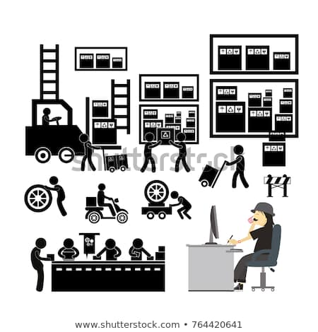
Suppliers
Supplier An organization that provides goods or services to another organization.
Supplier Tier or Level
Supply Chain
Tier 2
Tier 1
Notes:
Supplier: An organization that provides goods or services to another organization.
Suppliers are also known as vendors or contractors.
They are an important market stakeholder of business.
They provide critical inputs.
They often manufacture entire products that companies then sell to customers under their own brand.
Major transnational firms can have an enormous number of suppliers.
Example: Intel has 19,000 suppliers in 100 countries.
Lead firms often categorize their suppliers according to tier, or level.
Tier-1 suppliers (sometimes called contractors)
Hired to manufacture products and provide them directly to the company.
These may in turn work with tier-2 suppliers.
Tier-2 suppliers (sometimes called subcontractors)
Who may in turn work with even more distant suppliers.
Supply Chain
The multiple steps involved in the movement of a product or service from the most distant supplier to the customer.
Because of the complexity of these systems, firms sometimes refer to their supply webs or networks, rather than use the term supply chain, which implies a simple, linear relationship.

Slide 3
Suppliers2
Most suppliers share an interest in obtaining orders that will enable them to achieve their goals
Suppliers may have both economic and informational power.
Some suppliers have more leverage than others.
Notes:
Most suppliers share an interest in obtaining orders that will enable them to:
Make money.
Use their productive capacity efficiently.
Build long-term, stable relationships with business customers.
Suppliers may have both economic and informational power.
A supplier that is a sole source for a key component or natural resource naturally has more leverage than one which is not.
Suppliers that control critical worker skills, technical know-how, or relevant manufacturing infrastructure have more leverage than others.

Slide 4
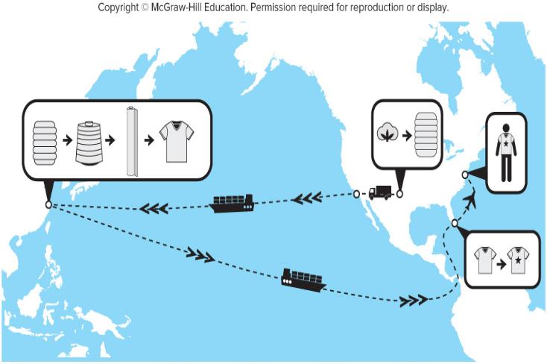
A Supply Chain Map for a Cotton T-Shirt
Figure 17.1
Copyright © McGraw-Hill Education. Permission required for reproduction or display.
Access the text alternative for these images.

Slide 5

Social, Ethical, and Environmental Issues
Three key issues in global supply chains:
  Social issues.
  Ethical issues.
  Environmental issues.
Notes:
We will talk more about these in following slides

Slide 6

Social Issues
Supply Chain Issues
Wages
Sweatshops
Business Challenges
Notes:
Global supply chains have many social impacts.
Prominent among them are the wages, working conditions, and health and safety of employees in supplier factories.
Low wages are one of the main reasons that brands contract with suppliers in developing countries.
They reduce overall costs and enable brands to price their products more competitively.
Low wages are not necessarily unethical.
However, if a company’s customers believe that its products are made in sweatshops, its reputation can be harmed.
Sweatshops—a derogatory term referring to factories where workers toil long hours, at low wages, and under unsafe conditions.
Business Challenges
The challenge for businesses:
To assure that their suppliers pay wages that are perceived as fair.
To permit workers and their families to achieve a decent standard of living.
Minimum wages established by law may not be sufficient.
Terms and conditions of work varies across cultures and economies.
Finding the right balance can be a challenge:
→ For example, should excessive overtime be permitted, if workers want this?
Child labor.
Worker health and safety in supplier factories.

Slide 7
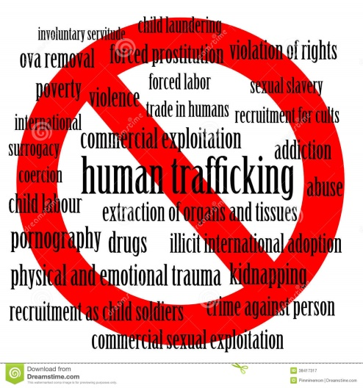

Ethical Issues1
Human Trafficking
Human Rights
Child Labor
Human Rights Challenge
Environmental Issues
Notes:
ETHICAL ISSUES
Human trafficking: Modern-day slavery—the illegal recruitment and movement of people against their will, usually to exploit them for economic gain.
Example: Of the estimated 25 million victims of trafficking in the world, about five million are women and girls forced into prostitution.
Companies that set up operations in countries with anti-democratic, repressive regimes can be caught up in violations of human rights.
Some governments require foreign firms to partner with state-owned companies in order to do business there, adding another level of risk.
Child labor: Work that deprives children of their childhood, their potential and their dignity, and that is harmful to physical and mental development.
In 2017, 152 million children continued to work, most of them in agriculture and more than half in hazardous jobs.
Example: Nestlé sourced cocoa from farms who used child labor.
Human Rights Challenge
Transnational companies that depend on resources that are farmed, extracted, or mined are particularly at risk for human rights abuses by their suppliers.
A specific human rights challenge in global supply chains is sourcing minerals and other valuable commodities from conflict zones.
Environmental Issues
Arise when a supplier of raw materials, parts, or finished goods contributes to climate change, dumps toxic chemicals, emits air pollution, or reduces biodiversity.
This can threaten the reputation of companies at the top of the supply chain.
Some companies have responded to environmental concerns by:
Local sourcing: seeking to source from nearby suppliers where practical.
Improve efficiency in their supply chains.

Slide 8


Supply Chain Issues
Supply Chain Risk
Supply Chain Transparency
Notes:
Supply Chain Risk
Failure to manage social, ethical, and environmental risk in supply chains can be very costly, managers have learned.
Impact on stock prices of disruptions in companies’ supply chains.
Operating income, return on sales, and return on assets were all adversely impacted, and firms did not recover quickly.
Supply chain transparency: What happens in a company’s supply chain is fully disclosed to stakeholders—as if seen through a clear glass window.
Some firms have realized that openly revealing supply chain information can enhance brand loyalty among consumers concerned about social, ethical, and environmental responsibility.
Technology increasingly makes this possible at the point of purchase.
Consumers can see how and where a product was made in startling detail.

Slide 9
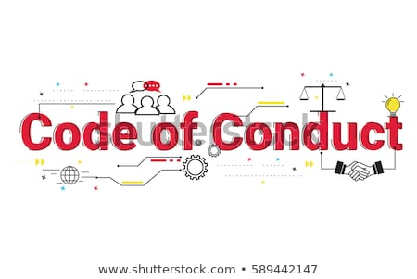
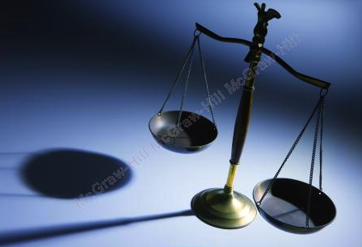
Private Regulation of the
Business – Supplier Relationship1
Reasons for private regulation
Global Environment
Private regulation
Notes:
Reasons for private regulation
Lack of jurisdiction of home country governments.
Weak regulatory capacity in developing countries.
Limited enforcement power of transnational institutions.
Global Environment
As the manufacturing supply chain has become increasingly globalized, its regulation has become more fragmented and ineffective.
New institutions have arisen to fill the void created by the inability of governments in both developed and developing countries to police the far-flung operations of large transnational corporations and their global supply chains.
Private regulation: Non-governmental institutions that govern, enable and constrain economic activities.
It also called as private governance.
It occurs when companies set rules of behavior for themselves and their business partners.
Private regulation often takes the form of company and industry-wide codes of conduct that establish standards governing labor, human rights, environmental, and related practices within global supply chains.
In the absence of effective public regulation, many companies and industries have established rules for their suppliers through their own voluntary supply chain codes of conduct.
→ Example: Levi Strauss, a U.S. apparel maker.

Slide 10
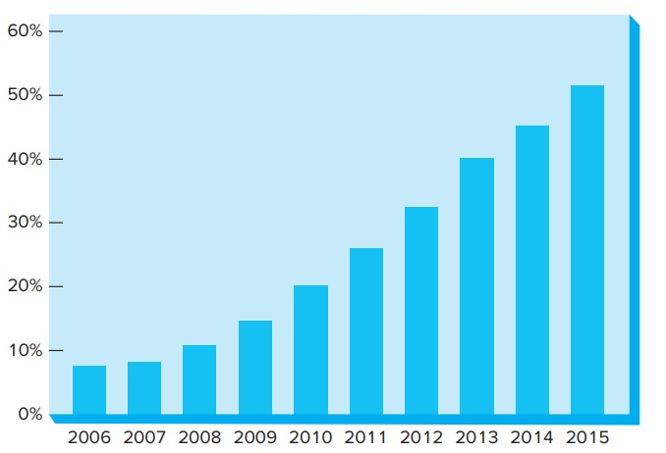
Percentage of Firms in Developed Countries with a Supply Chain Code of Conduct, 2006-2015
Figure 17.2
Copyright © McGraw-Hill Education. Permission required for reproduction or display.
Access the text alternative for these images.

Slide 11

Private Regulation of the
Business – Supplier Relationship3
Factors Affecting Adoption of Chain Codes of Conduct
Reasons Why Firms Invest in Supplier Social Responsibility
Common Industry-wide Standards
Notes:
Scholars have hypothesized that supply chain codes of conduct are most likely to be adopted by firms that:
Have highly valuable brands and are therefore more vulnerable to reputational damage.
Are highly scrutinized by the investment community, including activist shareholders.
Are headquartered in countries with strong unions, social welfare policies, and cooperative relationships among government, business, and labor.
Are members of industry coalitions or country networks, such as those sponsored by the United Nations Global Compact, that promote supply chain responsibility.
Are targets of pressure for responsible practices by nongovernmental organizations through:
Example: Campaigns, boycotts, or shareholder resolutions.
Firms invest in supplier social responsibility in order to:
Create a positive customer image and enhance brand equity.
Reduce costs.
Satisfy government regulations.
Avoid disruptions.
Increase sales.
Allay public criticism.
Common Industry-wide Standards
A current trend is adoption of common standards within industries.
→ Example: The Responsible Business Alliance Code of Conduct.
Common standards improve compliance, since suppliers are not faced with myriad conflicting demands.
Reduce the costs of monitoring since brands can share audit results.

Slide 12
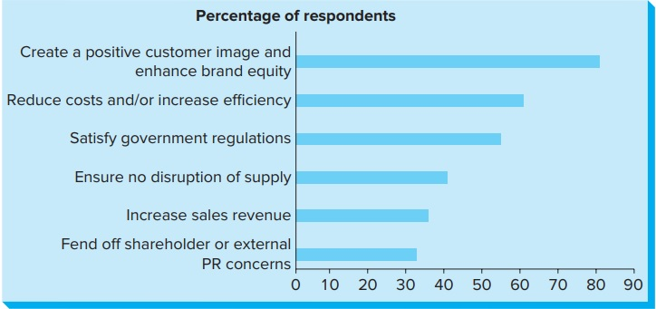
Drivers of Social and Environmental Responsibility in Supply Chains
Copyright © McGraw-Hill Education. Permission required for reproduction or display.
Figure 17.3
Access the text alternative for these images.

Slide 13
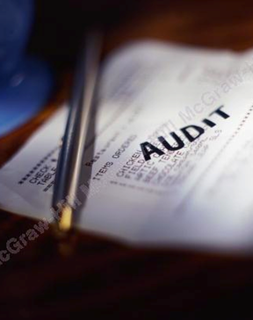
Supply Chain Auditing1
A supply chain audit monitors a supplier’s performance to determine if it is in compliance with the relevant code of conduct.
Choices in carrying out an audit:
  Internal audit.
  External audit or a third-party audit.
  Crowd-Sourced Audit
Notes:
A supply chain audit monitors a supplier’s performance to determine if it is in compliance with the relevant code of conduct.
Choices in carrying out an audit:
Internal audit.
External audit or a third-party audit.
Internal audit: Company hires and trains its own staff of auditors whose job is to inspect factories to determine whether or not they are in compliance.
Advantage: the company controls and manages the process. It can determine what factories need to be audited, and learn immediately about any problems uncovered.
Disadvantage: Stakeholders might view reports based on an internal audit as less credible because the company would have an interest in casting itself and its suppliers in a favorable light.
External audit: Company hires another organization to carry out the audit and report back to the company.
Also called a third-party audit.
Advantage: It is often perceived by stakeholders as more objective and credible.
Disadvantage: Company may find that the information is delayed, and it does not directly control the quality of the audit.
Crowd-sourced audit: gathers information about factory conditions directly from workers using their mobile phones.
Workers provide information directly by responding to questions generated by a recorded voice on their mobile phones when they are away from work.
→ Example: LaborVoices.

Slide 14

Audit – Drawbacks
Audits are
expensive and
time-consuming.
not always unannounced.
Notes:
On-site inspections are expensive and time-consuming.
Therefore cannot be scaled to cover a brand’s entire supply chain.
Audits are not always unannounced.
In many cases, suppliers receive advance notice and are able to stage conditions to pass the inspection.
Workers sometimes distrust auditors, not knowing if the inspectors represent the supplier, the brand, or an independent third party.
Therefore are reluctant to share their experiences.

Slide 15

Supply Chain Auditing2
Companies are working together to audit major suppliers and to share results.
To avoid audit fatigue
To spare companies from duplicating efforts
Notes:
Companies are working together to audit major suppliers and to share results.
To avoid audit fatigue:
Occurs when supplier factories must endure audit after audit conducted by different buyers.
To spare companies from duplicating efforts and incurring unnecessary costs:
Example: EcoVadis.

Slide 16

What do companies do when an audit reveals a gap?
Most audits turn up at least some instances in which a company’s global operations are not in compliance.
Terminate a supplier
Develop supplier capabilities
Notes:
What do companies do when an audit reveals a gap?
Most audits turn up at least some instances in which a company’s global operations are not in compliance.
A company will terminate a supplier, if the supplier is unwilling to change or the deficiencies are egregious.
Forty-eight percent of companies in a recent survey said they would terminate a supplier in certain cases if violations were found.

Slide 17
Supplier Development and
Capability Building1
Supplier development: Activities undertaken by companies to improve the performance of firms in their supply chains.
  A lead firm may choose instead to invest time and resources to build the supplier’s capabilities rather than terminate or punish a supplier.
Lead firms decide to engage in capability-building because the cost of switching suppliers may be too high.
  A supplier may have critical capabilities.
  The lead firm may feel a moral obligation to the workers and local community not to cause job loss.
  Other suppliers may not be readily available to take over the contract.

Slide 18
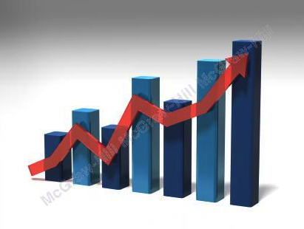
Supplier Development and
Capability Building2
Lead firms can provide a variety of rewards or incentives to suppliers that collaborate to build capabilities.
Supplier development may take several forms
Organizational mechanisms to resolve differences
Notes:
Lead firms can provide a variety of rewards or incentives to suppliers that collaborate to build capabilities.
Capability-building initiatives work best where interactions between buyer and supplier are frequent and ongoing.
Suppliers are more likely to engage when lead firms are prepared to offer them stable and long-term contracts.
Supplier development may take several forms:
Training.
Joint problem-solving.
Investing in equipment or infrastructure.
Some companies have invested directly in improving the lives and professional skills of their suppliers’ workers.
Example: Gap Inc., the apparel retailer, supports a program called Personal Advancement and Career Enhancement, or P.A.C.E.
Root cause analysis: Determine the underlying cause of repeated violations of particular code requirements or standards.
Companies have developed organizational mechanisms to resolve differences in priorities internally, and tried to communicate expectations more clearly to suppliers.
Integrated supplier scorecards: Rate suppliers on multiple dimensions:
Traditional measures: such as cost, quality, and timelines.
Newer measures of social, ethical, and environmental performance.
→ Example: Nike has introduced a Manufacturing Index which measures and rewards suppliers on four dimensions:
Quality.
On-time delivery.
Cost.
Sustainability.

Slide 19
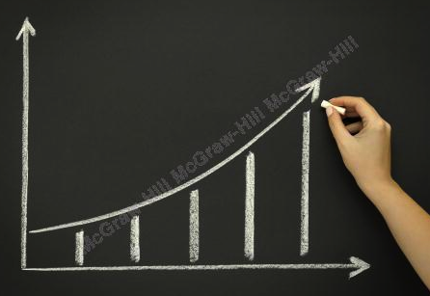
Supplier Development and Capability Building - Benefits
Research shows that when companies invest in suppliers and their employees, exchange knowledge, and collaborate on improvements, they create shared value that benefits both parties.

Slide 20
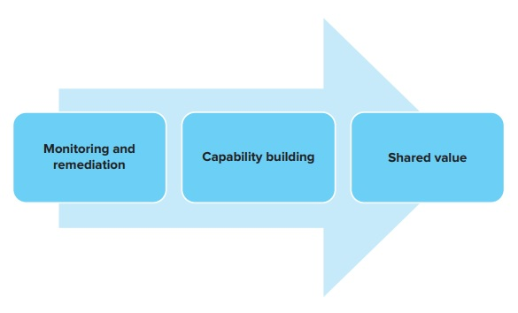
Lead Firm Responses to Supply Chain Audits of Social, Ethical, and Environmental Performance
Figure 17.4
Copyright © McGraw-Hill Education. Permission required for reproduction or display.
Access the text alternative for these images.

Slide 21
End of Main Content
Notes:
Closing slide.

Slide 22
Accessibility Content:
Text Alternatives for Images

Slide 23
A Supply Chain Map for a Cotton T-Shirt
Text Alternative
The raw cotton is grown and baled in Texas. From there it is taken by truck to the coast of Southern California. The raw materials are then transported via ships to China where the cotton is refined and transformed into plain T-shirts. The T-shirts are then shipped back to Florida in the United States via the Panama Canal for branding. The branded T-shirts are then distributed to target markets for sale to the public. The last step in the chain depicts a person wearing the branded shirt after flying from Florida to Washington, D.C.
Return to slide containing original image.

Slide 24
Percentage of Firms in Developed Countries with a Supply Chain Code of Conduct, 2006-2015 Text Alternative
The x-axis has ten markers from left to right that indicate years, starting with 2006 and ending with 2015.
The y-axis reflects the percentage of companies who have adopted codes of conduct and has seven markers. From bottom to top they are labeled from 0 percent to 60 percent, in increments of ten.
The bar graph data from left to right shows a continuous rise as follows:
2006 about 8 percent; 2007 close to 9 percent; 2008 at 11 percent; 2009 near 13 percent; 2010 reaches 20 percent; 2011 jumps to about 26 percent; 2012 climbs to around 30 percent; 2013 increases to 30 percent; 2014 is near 40 percent; and 2015 hits an all-time high of just over 50 percent.
Return to slide containing original image.

Slide 25
Drivers of Social and Environmental Responsibility in Supply Chains Text Alternative
The x-axis represents percentages and from left to right is labeled from 0 to 90 in increments of ten.
The y-axis lists six reasons why companies adopt responsible supplier initiatives.
From top to bottom the graph data reads as follows for each reason:
Create a positive customer image and enhance brand equity tops the chart at 80 percent.
Reduce costs and/or increase efficiency is second at 60 percent.
Satisfy government regulations is about 55 percent.
Ensure no disruption of supply ranks at around 40 percent.
Increase sales revenue was the reason for about 38 percent.
Fend off shareholder or external PR concerns was the lowest reason at about 32 percent.
Return to slide containing original image.

Slide 26
Lead Firm Responses to Supply Chain Audits of Social, Ethical, and Environmental Performance Text Alternative
The image contains an arrow that points from left to right. There are three rectangular boxes positioned on this arrow. From the left to the right, the content in the first box reads monitoring and remediation, the content in the second box reads capability building, and the content in the third box reads shared value.
Return to slide containing original image.

